Slide 1
Priors and how to choose them
Priors in Bayesian Phylogenetics

Slide 2
Priors denote our prior belief/expectations in certain parameter values
Tree Prior describes how a tree was formed by a population model
Prior belief of what the parameters should be
Posterior probability
Tree likelihood
Du Plessi et al., 2015, Trends M.

Slide 3
Practical example: Choosing priors on the evolutionary rates for SARS-CoV-2
What are related viruses (preferably in the same host)
SARS
MERS
What are their evolutionary rates

Slide 4
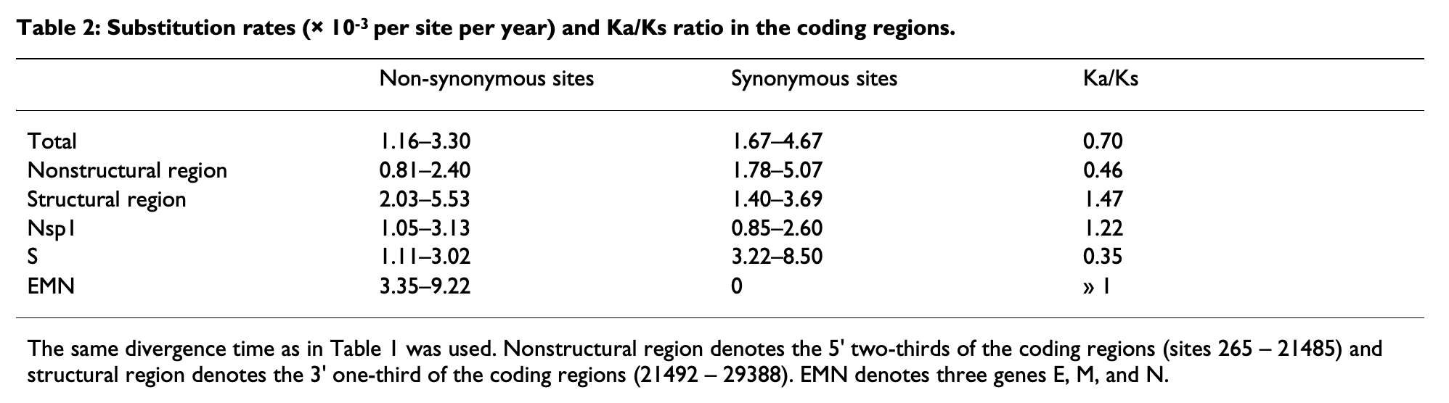
SARS evolutionary rate
Zhang et al., 2004, BMC Evol.

Slide 5

MERS evolutionary rate
Dudas et al., 2018, eLife

